Slide 1
International Chinese Language Competition (ICLC)
Briefing For Students

Slide 2
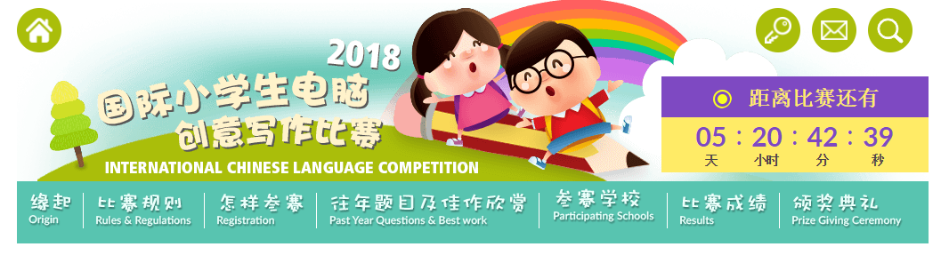
International Chinese Language Competition
Website
Open an internet browser and input this URL: https://iclc.swiiit.com/
How to login to participate in the competition?
Click on the login button

Slide 3
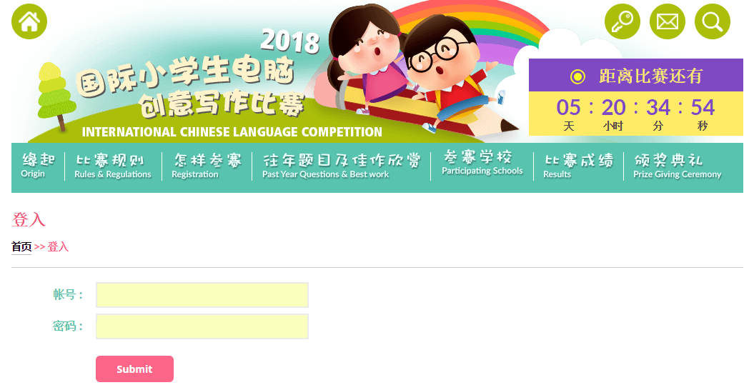
Login Page
Fill in the login ID and Password
Click on the submit button to login.

Slide 4

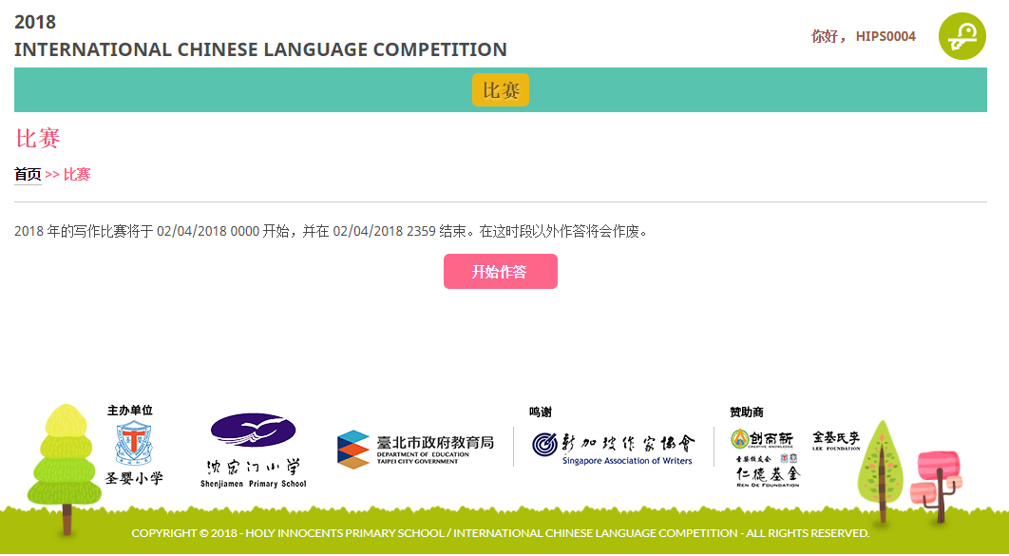
To Start the Competition
This is the interface that the students will see upon successfully logged in.
To start the competition, click on the .

Slide 5
Competition
There are two parts in the competition.
- First part is 故事接龙 and the second part is 看图写话.
第一部分：故事接龙
参赛者必须根据提供的故事开头段，完成有关的故事。（最少三百字）
第二部分：看图写话
参赛者必须根据图片加以发挥，可以采用各种文体，如：儿歌、短文、对话等等。
注意：必须完成两个部分

Slide 6
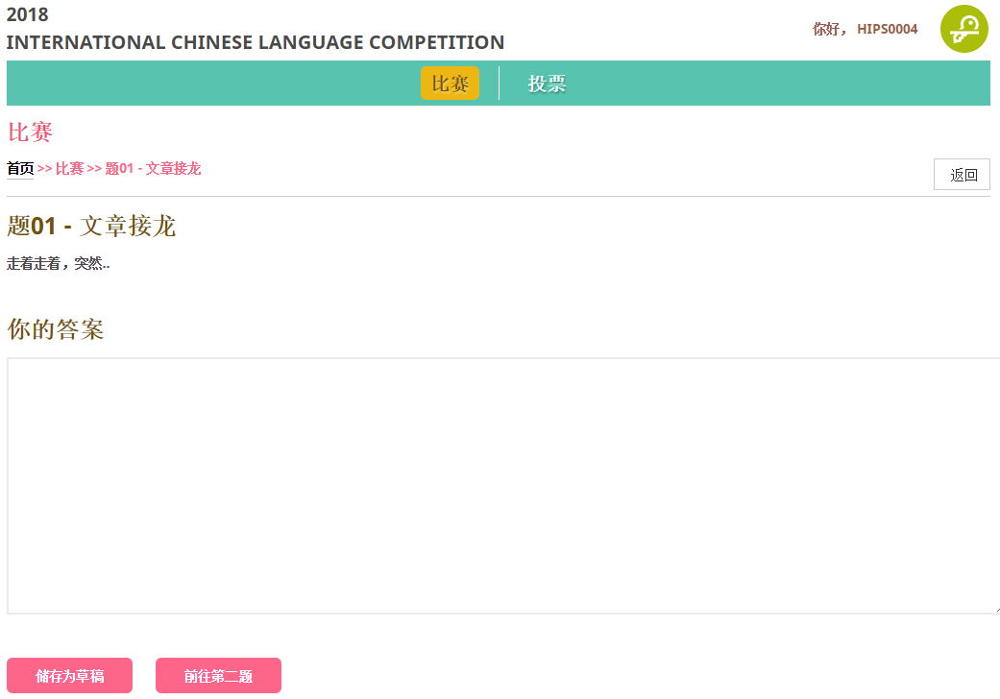
Part 1:故事接龙
Click here to return to homepage.
Input your answer here.
Click here to save as draft if you want to take a break and continue later.
Once you completed part 1, click here to proceed to part 2 of the competition.

Slide 7
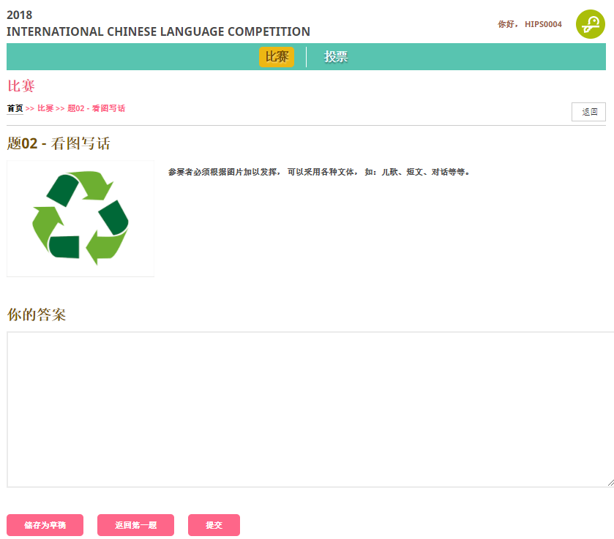
Part 2:看图写话
Click here to return to homepage.
If you wish to return part 1 to edit, please click on this button.
Input your answer here.
Click here to save as draft if you want to take a break and continue later.
Once you completed part 1, click here to proceed to part 2 of the competition.

Slide 8
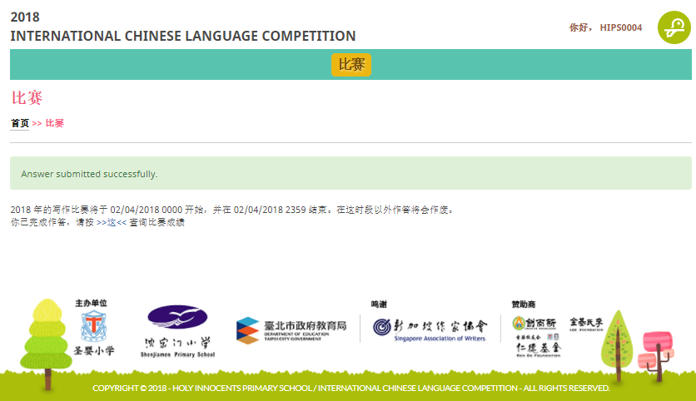
After Submission of Answers For The Competition
You will be redirected to this page once the answers submitted successfully.

